Slide 1
CSS Multiple backgrounds
Nicholas Holmes
CIT 230 Web Front-end Development

Slide 2
What does multiple backgrounds mean?
Simply put, it means you can apply more than one background to an HTML element.
The backgrounds are layered one atop of another. It layers them with the first background listed as the top layer and the last background listed as the bottom layer. If you want to use a color as one of the layers, it can only be used in the last layer.

Slide 3
You can use any of the background properties when using multiple backgrounds. Each property is applied to the background that corresponds to its order. This means the first value listed applies to the foremost layer and the last value listed applies to the backmost layer.

Slide 4
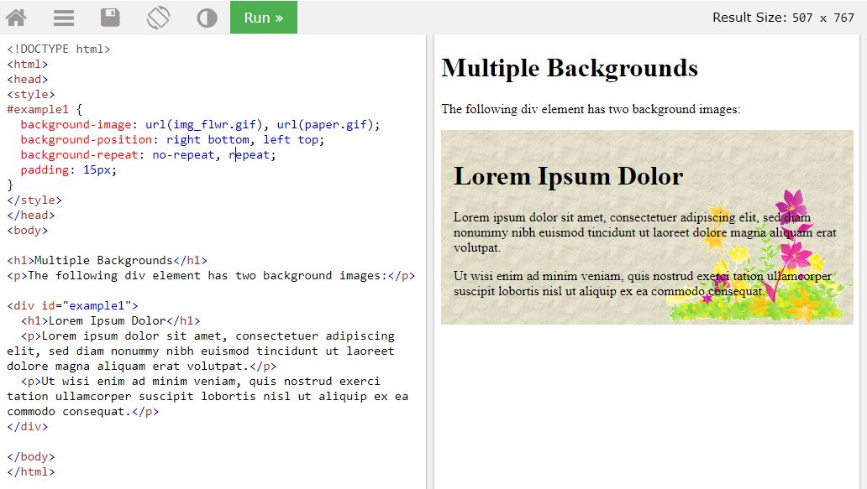
One of the most common uses of multiple backgrounds is to layer one image on top of another as seen below:

Slide 5
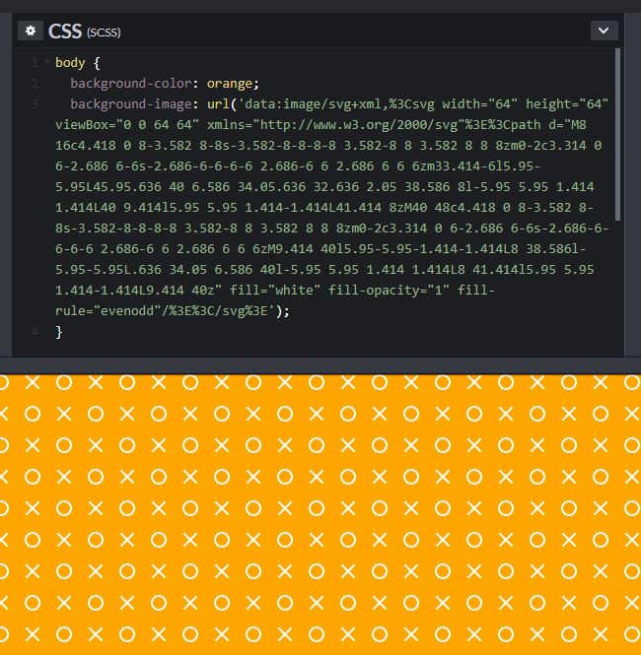
You can even use backgrounds not saved locally.
https://codepen.io/chriscoyier/pen/qxmmQv

Slide 6

Example of multiple background images for a custom 404 page:
https://www.creativebloq.com/css3/get-grips-css3-multiple-background-images-9134280

Slide 7

Another common use of multiple backgrounds is for increasing perceived performance. This is similar to using progressive images.
Over half of a websites data is in the form of images.
Use multiple backgrounds to progressive load different sized versions of the same image to have a low quality image load quickly so visitors don’t see blank spaces while the higher quality image loads.
Helpful when you have lots of high quality images on your site and/or when you have visitors with slow connections.
According to the FCC 2018 Broadband Deployment Report more than 24 million Americans still don’t have broadband internet at home.
https://docs.fcc.gov/public/attachments/FCC-18-10A1.pdf

Slide 8
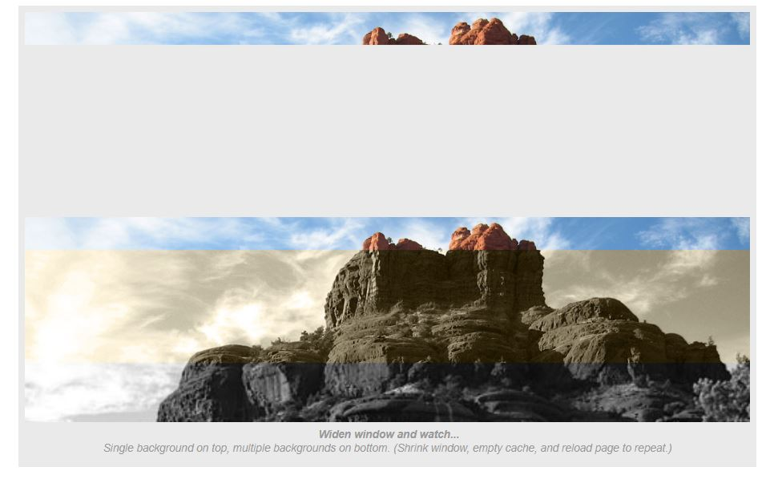
Last week Alex Brush did a great presentation on Progressive Images. I recommend watching to anyone that missed it. You can achieve a similar result using CSS Multiple Backgrounds.
https://css-tricks.com/examples/layeredlook/

